Slide 1
Ball Mill Grinder Project
MSE RUET
17 Series

Slide 2
Design Criteria
(Control)
Speed Control
Directional Control
Runtime Control
Rest time Control
Total time Control
Multiple Modes for total time control

Slide 3
Components

Slide 4
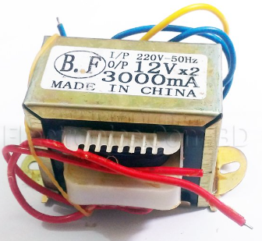
12V 3A

Slide 5
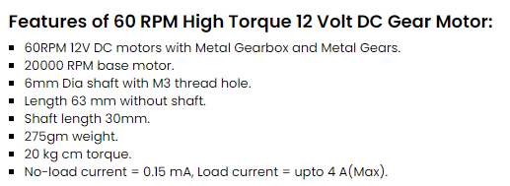
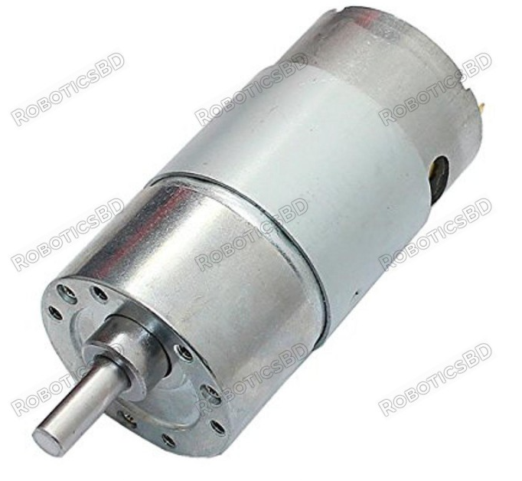
60 RPM 12 V DC motor

Slide 6
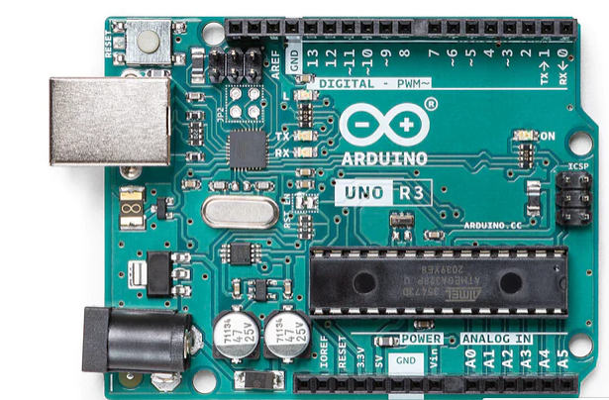
Arduino uno r3

Slide 7
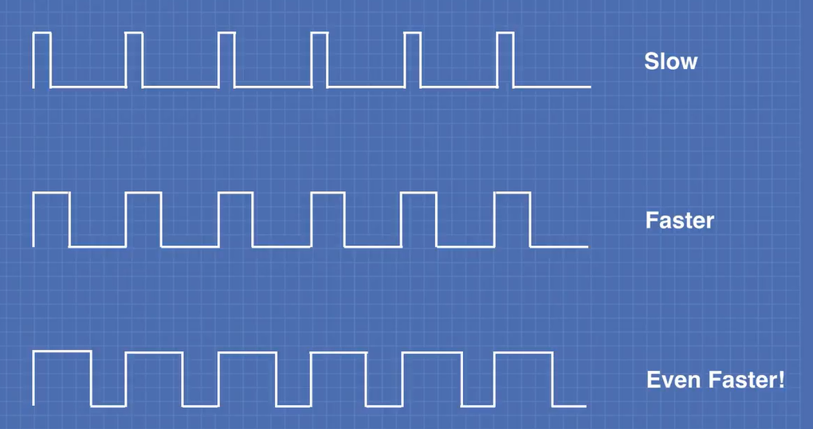
Pulse width module (pwm)

Slide 8
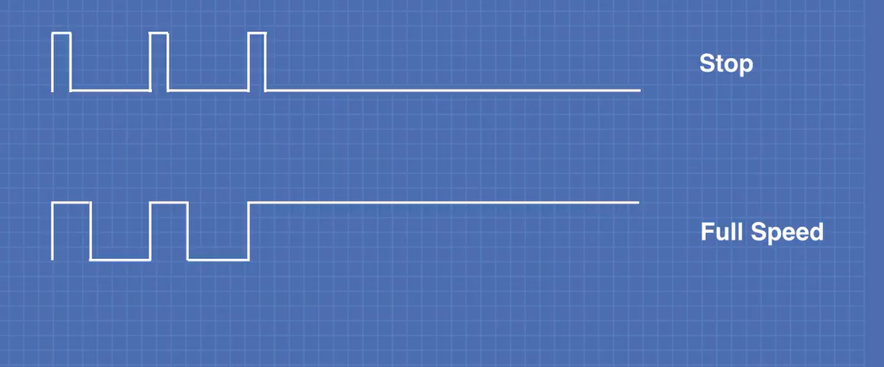
Pulse width module (pwm)

Slide 9
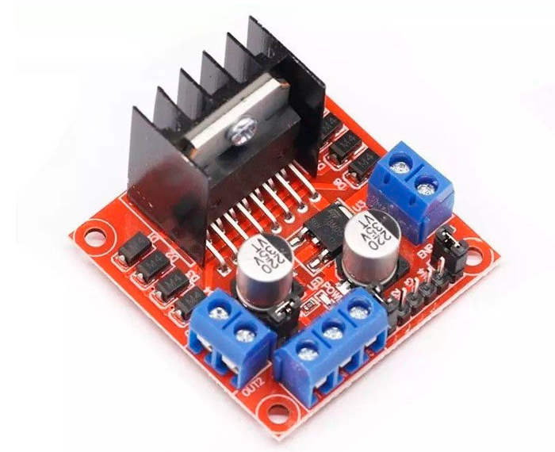
L298N
H-Bridge Dual Motor Driver

Slide 10
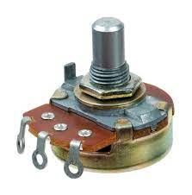
Potentiometer

Slide 11
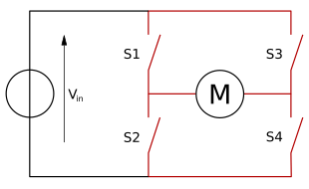
H-Bridge

Slide 12
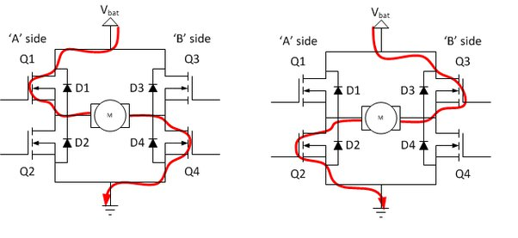
H-Bridge

Slide 13
Circuit Diagram

Slide 14
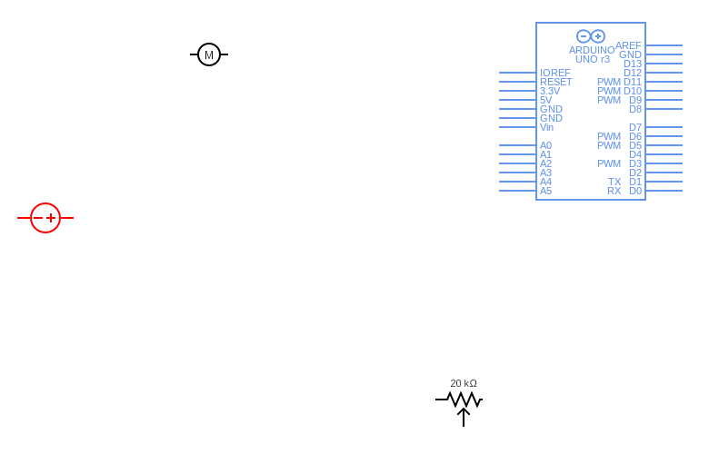
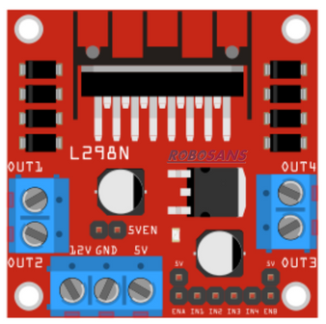

Slide 25
Code

